Slide 1
Common Coupling at File-Level and Method-Level Granularity
Intermediary Project Update
Kevin Nguyen, Jacqueline Wong - Team 4

Slide 2
Background Information
-Common Coupling
-“Common coupling (also known as Global coupling) occurs when two modules share the same global data (e.g., a global variable).” [1]
-File-Level Granularity
-Global variables and files that use them
-Method-Level Granularity - Instance Variables
-Per file, instance variables and methods that use them
[1] Wikipedia. https://en.wikipedia.org/wiki/Coupling_(computer_programming)

Slide 3
Technologies Used
-Java and Eclipse ASTVisitor
-Used to write the common coupling detection tool
-Similar to Assignment 4 (GeneralVisitor and MainVisitor)
-Various Java Systems
-The common coupling detection tool will be run on these Java systems.
-Ex. Freemind, CMS Java

Slide 4
Current Progress
-Completed most of the code
-Code is currently in a working state.
-Code To-Do:
-Refactoring and reorganizing code to improve efficiency
-Identify and implement edge cases (if any)
-Preliminary results of the program being run on Freemind and CMS Java.

Slide 5
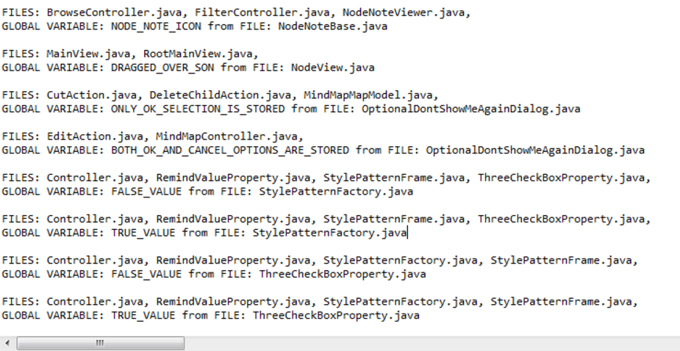
Major Milestones / Preliminary Results
-FreeMind Output (File-Level Granularity)

Slide 6
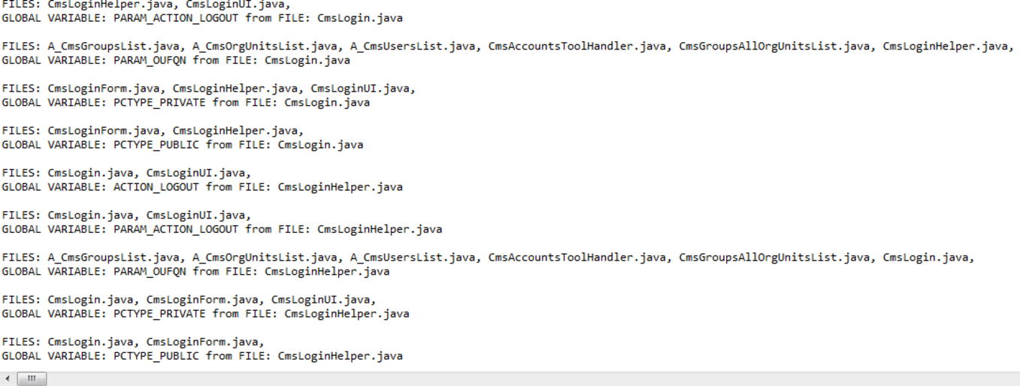
Major Milestones / Preliminary Results
-CMS Output (File-Level Granularity)

Slide 7
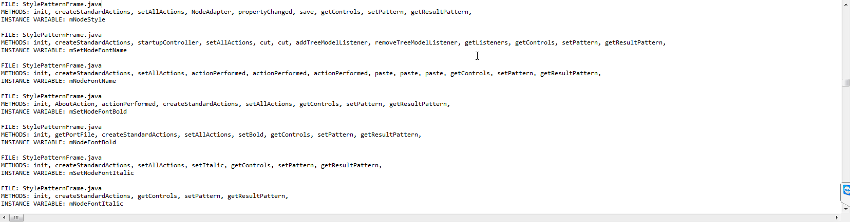
Major Milestones / Preliminary Results
-FreeMind Output (Method-Level Granularity)

Slide 8
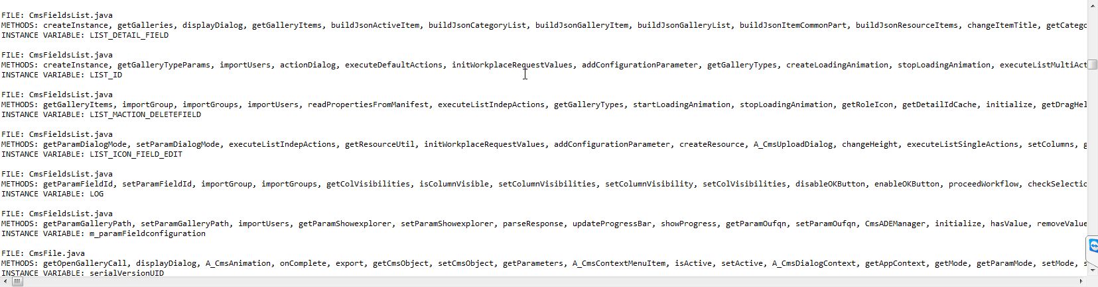
Major Milestones / Preliminary Results
-CMS Output (Method-Level Granularity)
Notes:
If asked, here are samples of full line result: http://i.imgur.com/SpED4lb.png

Slide 9
Revised Schedule
Date | Deliverable List
4/1 | Finalize project outline based on professor recommendations. Begin coding.
4/12 | Project Update Presentation Date. Have most or all of the code finished.
4/14 | Intermediary Project Report Due. Preliminary results for 1-3 systems.
4/21 | Complete final code revisions and finalize presentation-ready results.
4/26-4/28 | Final Project Presentation Date.
5/3 | Final Project Report Due.

Slide 10
Possible Additions (Time Permitting)
-Perform common coupling using srcML and compare results to Eclipse ASTVisitor.
-Compare to conceptual coupling using Lucene.
-Corpus Creation via text extraction
-Index via Latent Semantic Indexing
-Term-document matrix (Vector subspace)
-Cosine Similarity
-Value from 0 to 1

